Slide 1
Axon Classic models data analysis capstone project
Submitted by: Amrith Vasundharan
Batch: DS28A
OdinSchool

Slide 2
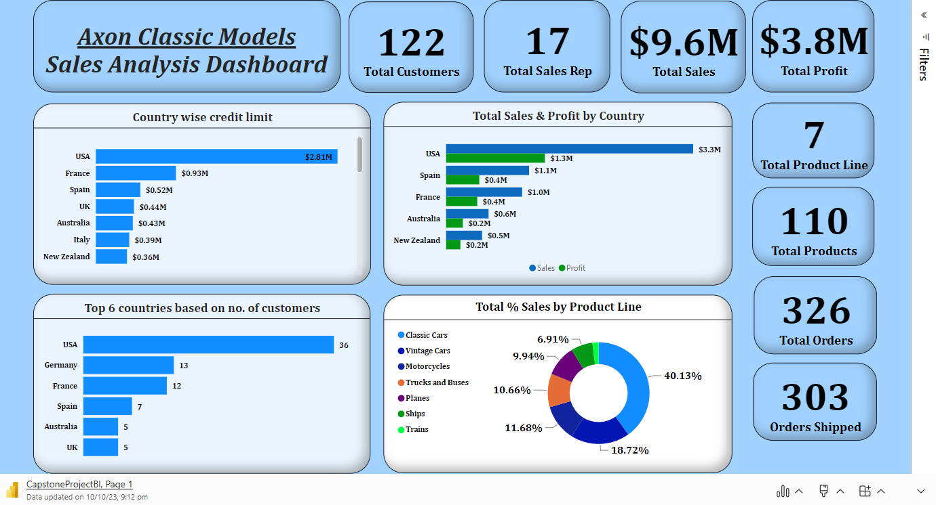

Slide 3
122 Total Customers
USA tops the chart for credit limit with $2.81 Million followed by France and Spain.
With 36,USA has maximum no. of customers followed by Germany and France.
Total Sales of $9.6 Million (Profit $3.8 Million).
Total 7 product categories and 110 different products.
17 Sales Representatives

Slide 4
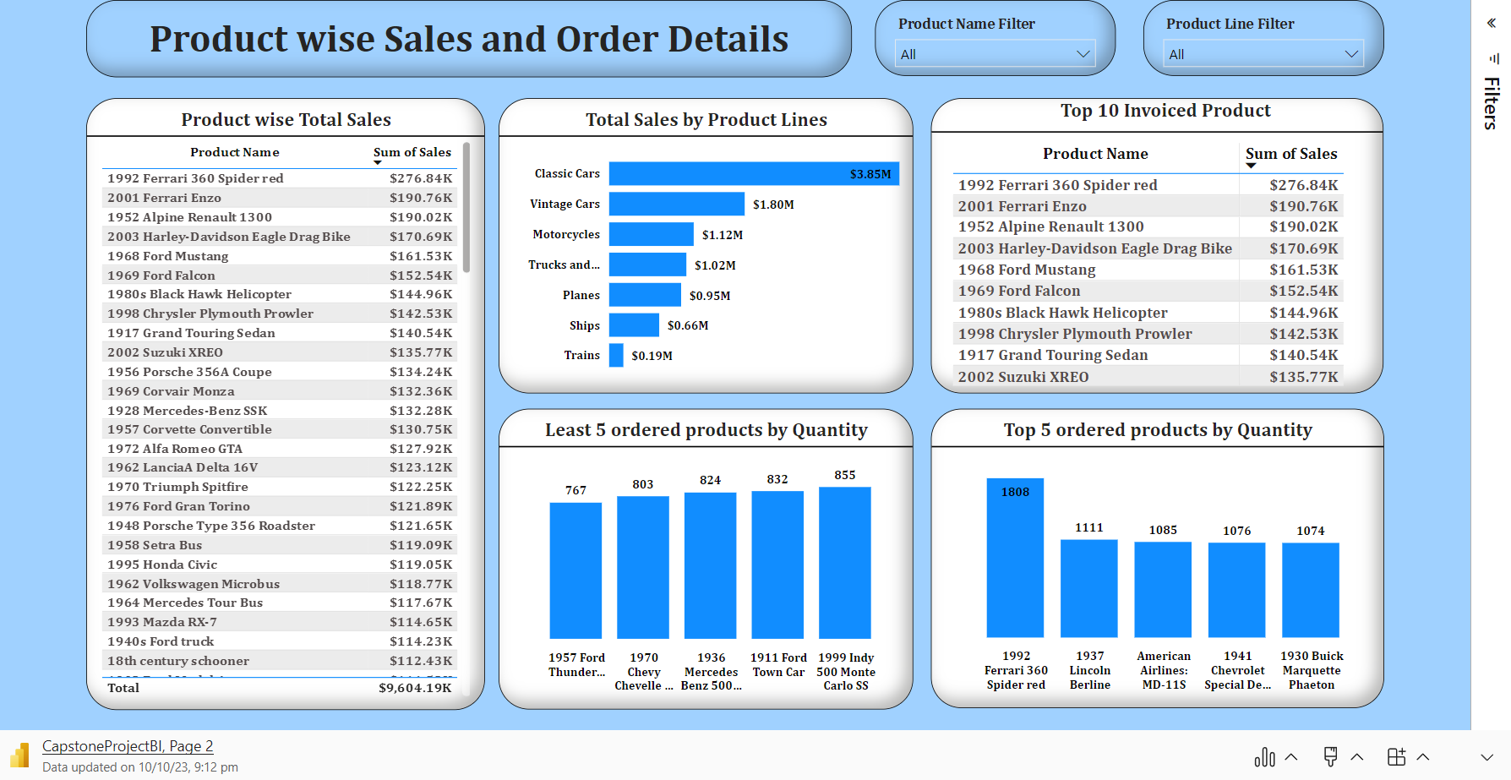

Slide 5
At $3.8 Million, Classic Cars had the highest Sum of Sales and was 1,944.16% higher than Trains, which had the lowest Sum of Sales at $0.188 Million
Classic Cars accounted for 40.13% of Sum of Sales.
Classic Cars, Vintage cars and Motorcyles contribute approx. 70% of the total sales.
Across all 7 product line, Sum of Sales ranged from $0.188 Million to $3.85 Million
Average Shipping Days is 3.76(approx. 4 days)

Slide 6
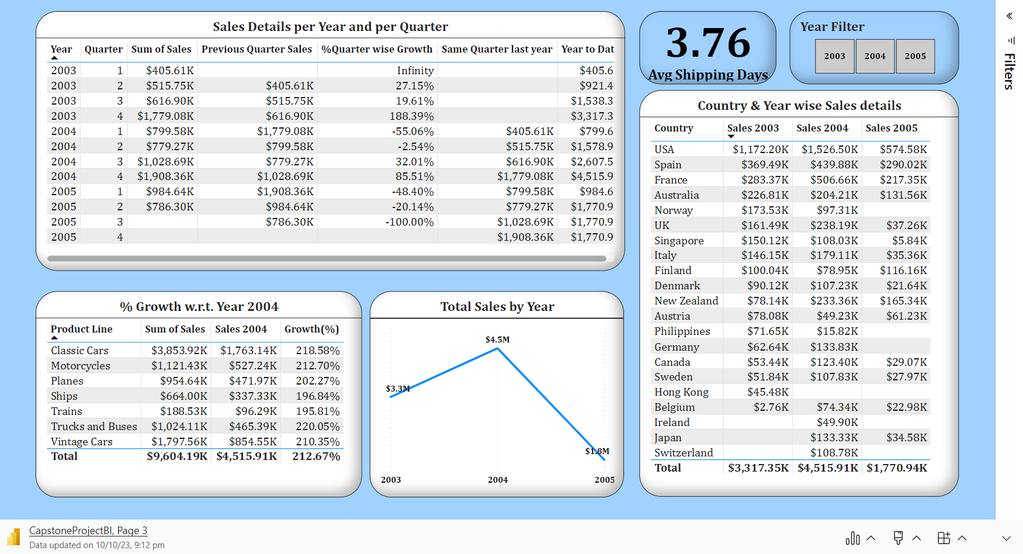

Slide 7
At $4.51 Million, 2004 had the highest Sum of Sales and was 155.00% higher than 2005, which had the lowest Sum of Sales at $1.77 Million.
2004 had the highest Sum of Sales at $4.51 Million, followed by 2003 at $3.31 Million and 2005 at $1.77 Million.
2004 accounted for 47.02% of Sum of Sales.
4th Quarter of 2004 had the maximum sales.
USA tops the chart for year wise sales.

Slide 8
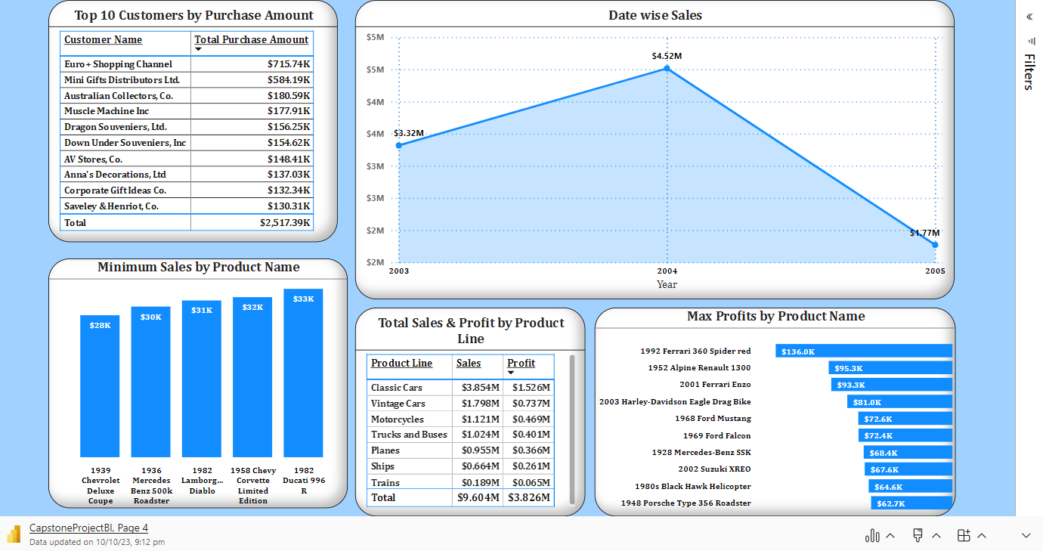

Slide 9
At $4.51 Million, 2004 had the highest Sum of Sales and was 155.00% higher than 2005, which had the lowest Sum of Sales at $1,770,936.71.
1939 Chevrolet Deluxe Coupe had the minimum sales over the entire period.
1992 Ferrari 360 Spider Red accumulated the maximum profit.
Euro + Shopping Channel leads the chart for maximum purchase amount with $715.5 .Thousand

Slide 10
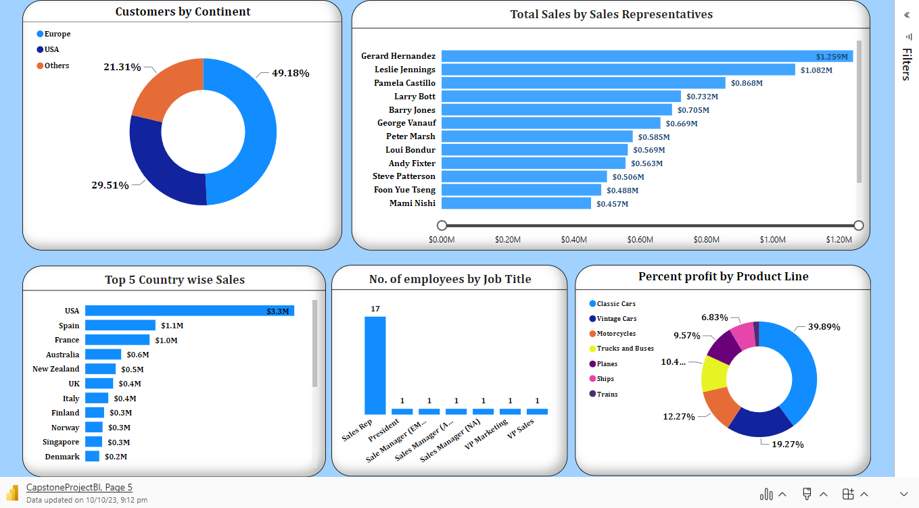

Slide 11
Continent wise Europe had the highest Count of customers at 60, followed by USA at 36 and Others at 26.
At $1,258,577.81, Gerard Hernandez had the highest Sum of Sales and was 262.15% higher than Leslie Thompson, who had the lowest Sum of Sales at $347,533.02.
Gerard Hernandez accounted for 13.10% of Sum of Sales.

Slide 12
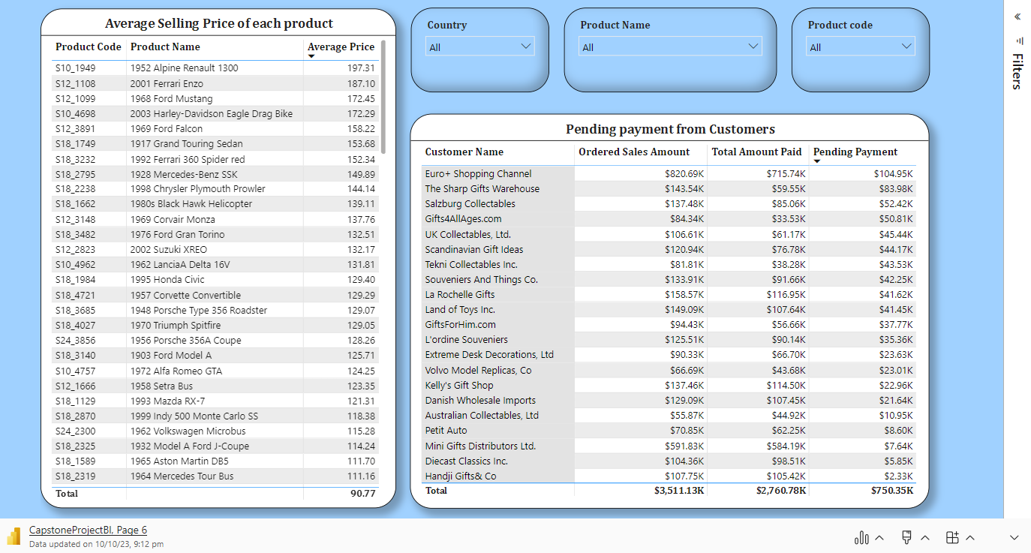

Slide 13
Euro + Shopping Channel has most pending payment followed by The Sharp Gift Warehouse followed by Salzburg Collectables.
Total pending amount from all customers sums to $750K.
Average Selling price of each product can observed and which can improved by applying corrective measures.
The available stock can also be viewed using the Power BI dashboard.

Slide 14
